Slide 1
LOAN STATUS PREDICTION
SUBMITTED BY-
PRIYANK JHA
(INTERN)
HENRY HARVIN EDU.PVT LTD

Slide 2
Problem statement
Understanding the problem statement is the first and foremost step. This would help you give an intuition of what you will face ahead of time. Let us see the problem statement -
Dream Housing Finance company deals in all home loans. They have presence across all urban, semi urban and rural areas. Customer first apply for home loan after that company validates the customer eligibility for loan. Company wants to automate the loan eligibility process (real time) based on customer detail provided while filling online application form. These details are Gender, Marital Status, Education, Number of Dependents, Income, Loan Amount, Credit History and others. To automate this process, they have given a problem to identify the customers segments, those are eligible for loan amount so that they can specifically target these customers.

Slide 3
Understanding the data
In this section, we will look at the structure of the train and test datasets. Firstly, we will check the features present in our data and then we will look at their data types.
train.columns
Index(['Loan_ID', 'Gender', 'Married', 'Dependents', 'Education', 'Self_Employed', 'ApplicantIncome', 'CoapplicantIncome', 'LoanAmount', 'Loan_Amount_Term', 'Credit_History', 'Property_Area', 'Loan_Status'], dtype='object')
We have 12 independent variables and 1 target variable, i.e. Loan_Status in the train dataset.
We have similar features in the test dataset as the train dataset except the Loan_Status. We will predict the Loan_Status using the model built using the train data.

Slide 4
Variable | Description
Loan_ID | Unique Loan ID
Gender | Male/ Female
Married | Applicant married (Y/N)
Dependents | Number of dependents
Education | Applicant Education (Graduate/Under Graduate)
Self_Employed | Self employed (Y/N)
ApplicantIncome | Applicant income
CoapplicantIncome | Coapplicant income
LoanAmount | Loan amount in thousands
Loan_Amount_Term | Term of loan in months
Credit_History | Credit history meets guidelines
Property_Area | Urban/ Semi Urban/ Rural
Loan_Status | Loan approved (Y/N)
.

Slide 5
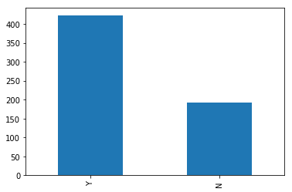
Univariate analysis
In this section, we will do univariate analysis. It is the simplest form of analyzing data where we examine each variable individually. For categorical features we can use frequency table or bar plots which will calculate the number of each category in a particular variable. For numerical features, probability density plots can be used to look at the distribution of the variable.
Target Variable
We will first look at the target variable, i.e., Loan_Status. As it is a categorical variable, let us look at its frequency table, percentage distribution and bar plot.
The loan of 422(around 69%) people out of 614 was approved.

Slide 6
Now lets visualize each variable separately. Different types of variables are Categorical, ordinal and numerical.
Categorical features: These features have categories (Gender, Married, Self_Employed, Credit_History, Loan_Status)
Ordinal features: Variables in categorical features having some order involved (Dependents, Education, Property_Area)
Numerical features: These features have numerical values (ApplicantIncome, CoapplicantIncome, LoanAmount, Loan_Amount_Term)
Let’s visualize the categorical and ordinal features first.

Slide 7
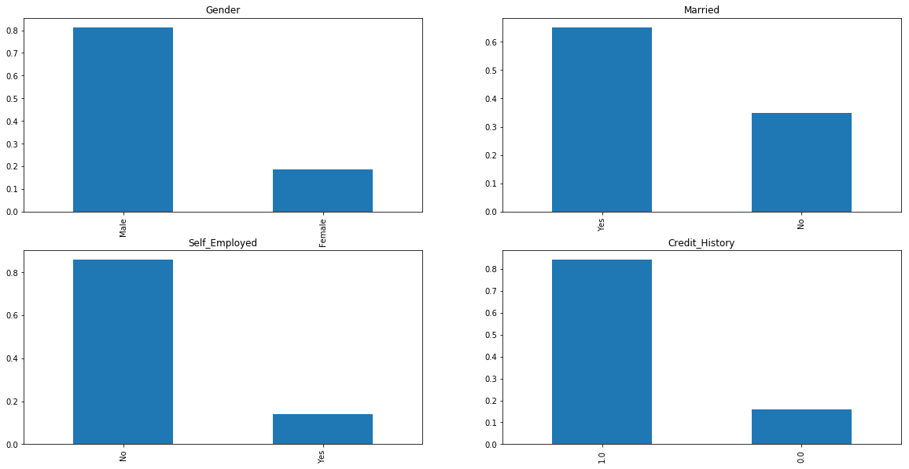
Independent variable-categorical
It can be inferred from the above bar plots that:
80% applicants in the dataset are male.
Around 65% of the applicants in the dataset are married.
Around 15% applicants in the dataset are self employed.
Around 85% applicants have repaid their debts.

Slide 8
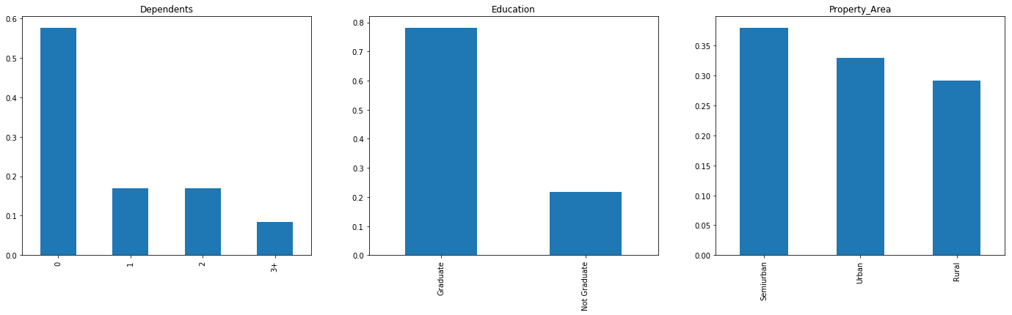
Independent variables-ordinal
Following inferences can be made from the above bar plots:
Most of the applicants don’t have any dependents.
Around 80% of the applicants are Graduate.
Most of the applicants are from Semiurban area

Slide 9
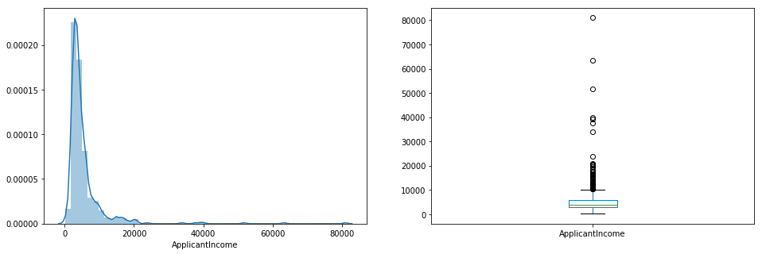
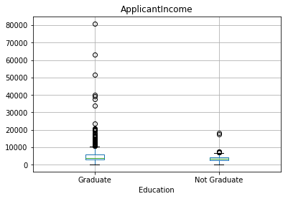
Independent variables-numerical
Till now we have seen the categorical and ordinal variables and now lets visualize the numerical variables. Lets look at the distribution of Applicant income first.
It can be inferred that most of the data in the distribution of applicant income is towards left which means it is not normally distributed
The boxplot confirms the presence of a lot of outliers/extreme values. This can be attributed to the income disparity in the society.
Let us segregate them by Education.
We can see that there are a higher number of graduates with very high incomes, which are appearing to be the outliers.

Slide 10
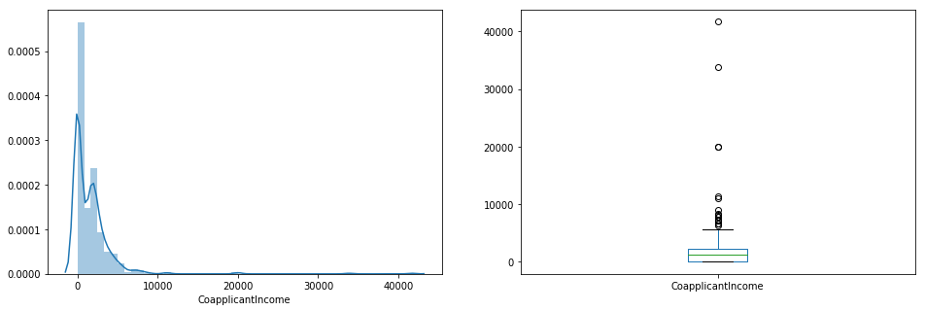
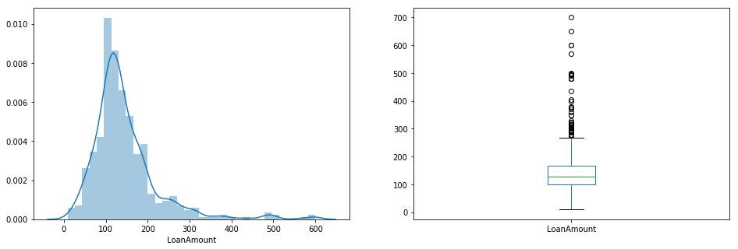
We see a lot of outliers in this variable and the distribution is fairly normal. We will treat the outliers in later sections..
We see a similar distribution as that of the applicant income. Majority of coapplicant’s income ranges from 0 to 5000. We also see a lot of outliers in the coapplicant income and it is not normally distributed
Now we would like to know how well each feature correlate with Loan Status. So, in the next section we will look at bivariate analysis.

Slide 11
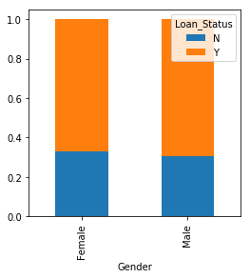
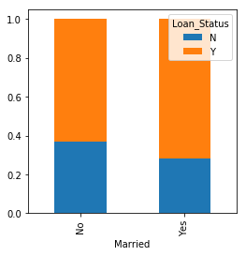
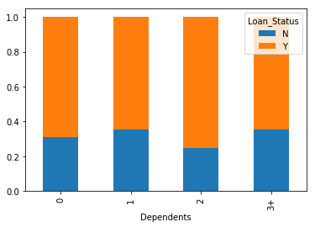
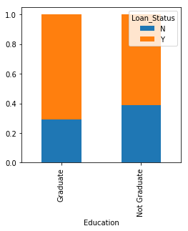
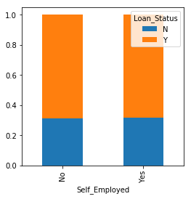
Bivariate analysis

Slide 12
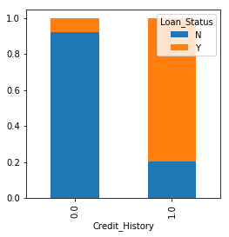
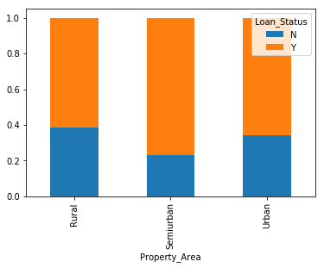
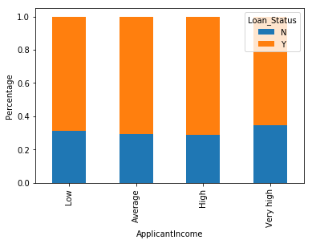
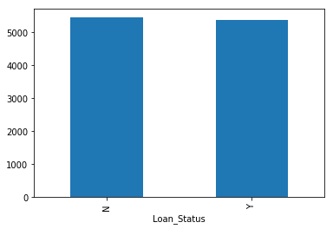
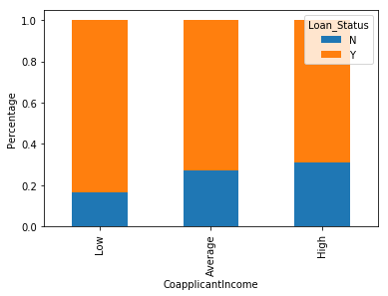
Continued….

Slide 13
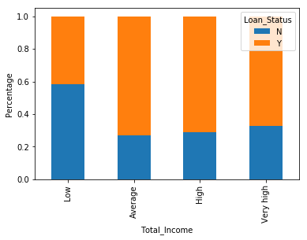
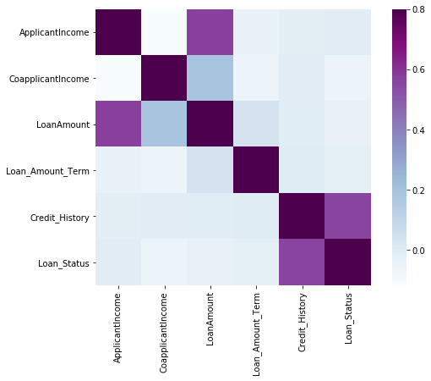
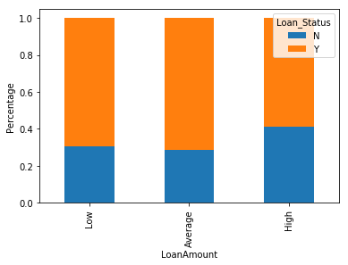
We see that the most correlated variables are (ApplicantIncome - LoanAmount) and (Credit_History - Loan_Status). LoanAmount is also correlated with CoapplicantIncome.

Slide 14
Missing values and outlier treatment
Let’s list out feature-wise count of missing values.
There are missing values in Gender, Married, Dependents, Self_Employed, LoanAmount, Loan_Amount_Term and Credit_History features.
We can consider these methods to fill the missing values:
For numerical variables: imputation using mean or median
For categorical variables: imputation using mode.

Slide 15
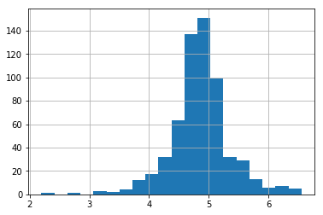
As we saw earlier in univariate analysis, LoanAmount contains outliers so we have to treat them as the presence of outliers affects the distribution of the data
Due to these outliers bulk of the data in the loan amount is at the left and the right tail is longer. This is called right skewness. One way to remove the skewness is by doing the log transformation. As we take the log transformation, it does not affect the smaller values much, but reduces the larger values. So, we get a distribution similar to normal distribution.
Now the distribution looks much closer to normal and effect of extreme values has been significantly subsided. Let’s build a logistic regression model and make predictions for the test dataset.

Slide 16
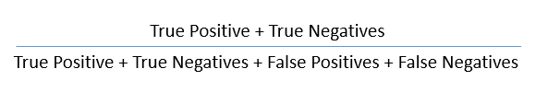
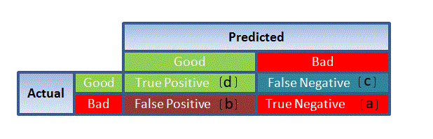
Evaluation metrics
Since this is a classification problem, we can evaluate our models using any one of the following evaluation metrics:
Accuracy: Let us understand it using the confusion matrix which is a tabular representation of Actual vs Predicted values. This is how a confusion matrix looks like:
Using these values, we can calculate the accuracy of the model. The accuracy is given by:

Slide 17
Precision: It is a measure of correctness achieved in true prediction i.e. of observations labeled as true, how many are actually labeled true.
Precision = TP / (TP + FP)
Recall(Sensitivity) - It is a measure of actual observations which are predicted correctly i.e. how many observations of true class are labeled correctly. It is also known as ‘Sensitivity’.
Recall = TP / (TP + FN)
Specificity - It is a measure of how many observations of false class are labeled correctly.
Specificity = TN / (TN + FP)
ROC curve
Receiver Operating Characteristic(ROC) summarizes the model’s performance by evaluating the trade offs between true positive rate (sensitivity) and false positive rate(1- specificity).
The area under curve (AUC), referred to as index of accuracy(A) or concordance index, is a perfect performance metric for ROC curve. Higher the area under curve, better the prediction power of the model.

Slide 18
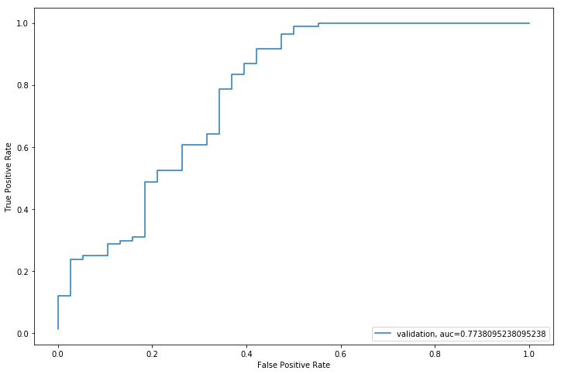
Model comparison
Logistic regression(5 fold cv)
Random forest algorithm
Our prediction gets accuracy score of 76.38%
RandomForest is a tree based bootstrapping algorithm wherein a certain no. of weak learners (decision trees) are combined to make a powerful prediction model.
For every individual learner, a random sample of rows and a few randomly chosen variables are used to build a decision tree model.
Final prediction can be a function of all the predictions made by the individual learners.
In case of regression problem, the final prediction can be mean of all the predictions
Our predictions gets the accuracy of 79.89%.
ROC Curve

Slide 19
Logistic regression using stratified k fold cross validation
from sklearn.model_selection import StratifiedKFold
To check how robust our model is to unseen data, we can use Validation. It is a technique which involves reserving a particular sample of a dataset on which you do not train the model. Later, you test your model on this sample before finalizing it.
Let’s import StratifiedKFold from sklearn and fit the model.
Now let’s make a cross validation logistic model with stratified 5 folds and make predictions for test dataset.
i=1 kf = StratifiedKFold(n_splits=5,random_state=1,shuffle=True)
for train_index,test_index in kf.split(X,y):
print('\n{} of kfold {}'.format(i,kf.n_splits))
xtr,xvl = X.loc[train_index],X.loc[test_index]
ytr,yvl = y[train_index],y[test_index]
model = LogisticRegression(random_state=1)
model.fit(xtr, ytr)
pred_test = model.predict(xvl)
score = accuracy_score(yvl,pred_test)
print('accuracy_score',score)
i+=1 pred_test = model.predict(test) pred=model.predict_proba(xvl)[:,1]
1 of kfold 5 accuracy_score 0.7983870967741935
2 of kfold 5 accuracy_score 0.8306451612903226
3 of kfold 5 accuracy_score 0.8114754098360656
4 of kfold 5 accuracy_score 0.7950819672131147
5 of kfold 5 accuracy_score 0.8278688524590164

Slide 20
The mean validation accuracy for this model turns out to be 0.81.
Let us visualize the roc curve.
from sklearn import metrics
fpr, tpr, _ = metrics.roc_curve(yvl, pred)
auc = metrics.roc_auc_score(yvl, pred)
plt.figure(figsize=(12,8))
plt.plot(fpr,tpr,label="validation, auc="+str(auc))
plt.xlabel('False Positive Rate')
plt.ylabel('True Positive Rate')
plt.legend(loc=4)
plt.show()
We got an accuracy value of 0.77.

Slide 21
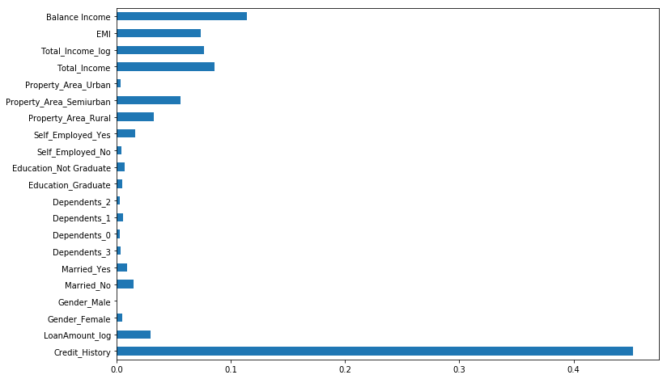
Feature importance
We can see that Credit_History is the most important feature followed by Balance Income, Total Income, EMI. So, feature engineering helped us in predicting our target variable

Slide 22
Conclusions and insights
After trying and testing different algorithms, the best accuracy on the public leaderboard is achieved by Logistic Regression (0.7847), followed by RandomForest (0.7638).

